Slide 1




SALESFORCE PROJECT
Charles Herriott

Slide 2
Aim of the project
ForceTraining is a new Salesforce training partner based in London.
They are looking to deliver public training courses.
They require a system building that will allow them to track the courses they have scheduled, the trainers who will deliver them and the creation and management of personal service and expense invoices for the instructors.

Slide 3
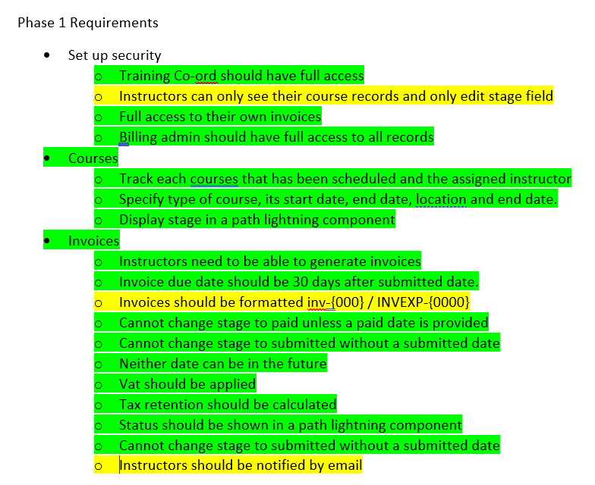
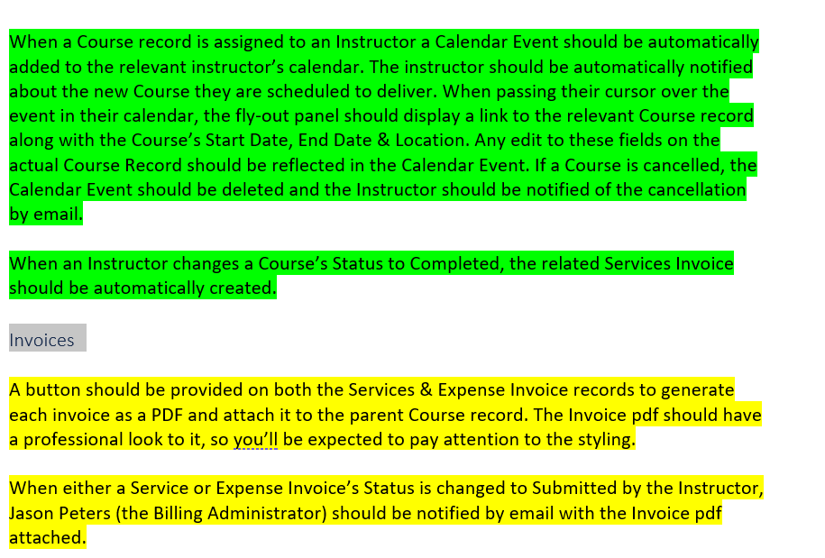
How did I approach the specification?

Slide 4
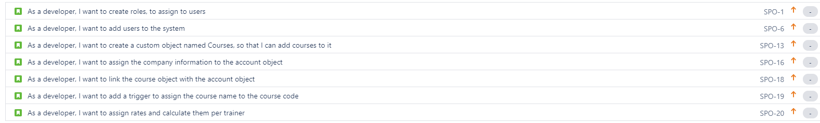
Jira Board and Planning
Whilst I did not keep my Jira up to date throughout the entirety of the project, it was helpful when breaking the project down into individual tasks.

Slide 5
Trailhead
This was a relatively enjoyable experience, though it can get mundane and hard to keep focused after a few hours.
There was an element of competition between our team which made it more enjoyable and easier to stay motivated.

Slide 6
Consultant Journey
Declarative Tools
Apex
Visualforce
CSS

Slide 7
What Have I Learnt?
How relationships function between objects
The differences between standard and custom objects
Security settings
How to create and manipulate objects and fields

Slide 8
Declarative Tools
Process Builder
Workflow Rules
Lightning App Builder

Slide 9
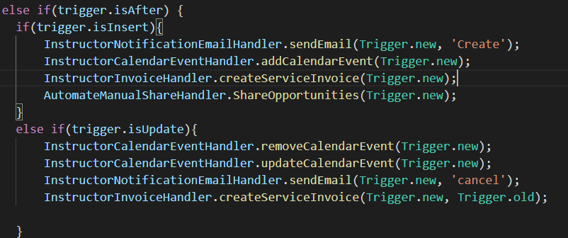
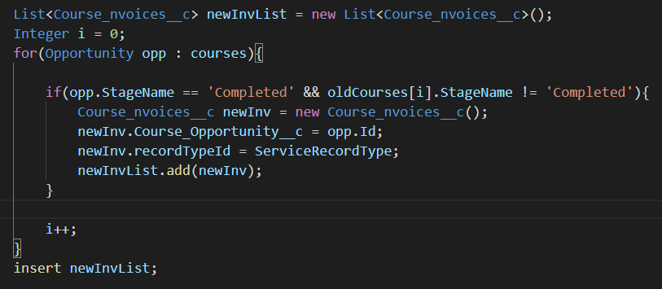
Apex Triggers and Classes

Slide 10
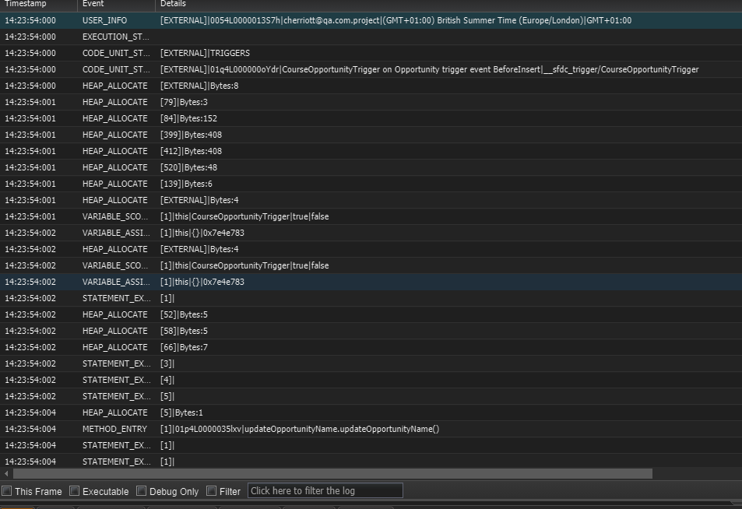
Apex Logs

Slide 11
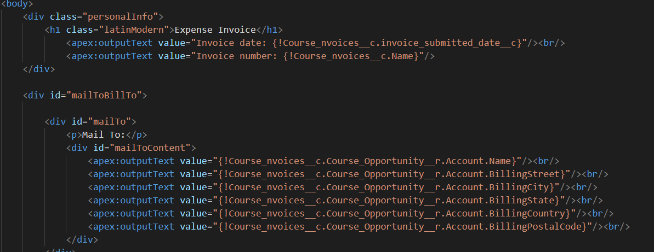
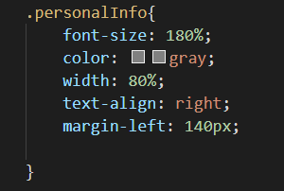
Visualforce Page & CSS

Slide 12
Demonstration Use Cases
Create an opportunity.
Set Stage to Scheduled.
Inspect automatically generated Service Invoice and Line Items.

Slide 13
Demonstration Use Cases
Create an opportunity.
Set Stage to Scheduled.
Set Location to London.
Create Expensive Invoice with auto mileage expenses done.

Slide 14
Demonstration Use Cases
Generate Service Invoice PDF
Generate Expense Invoice PDF

Slide 15
Demonstration Use Cases
Show Calendar Events through Peter Smith
Set Stage to cancelled to remove calendar events.

Slide 16
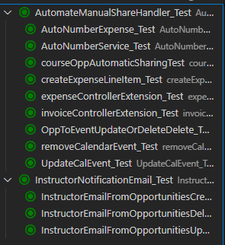
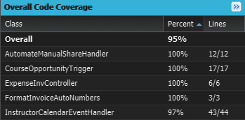
Apex Testing

Slide 17
Conclusion
What went well | What needs improving/ is missing
Getting to grips with the platform | More efficient apex
Most of the declarative tools | Visualforce / CSS within Apex
Apex | Security
Visualforce | Send email with attached PDF
Automation | Better CSS styling

Slide 18
Thanks for the listening! Any Questions?

